Slide 1
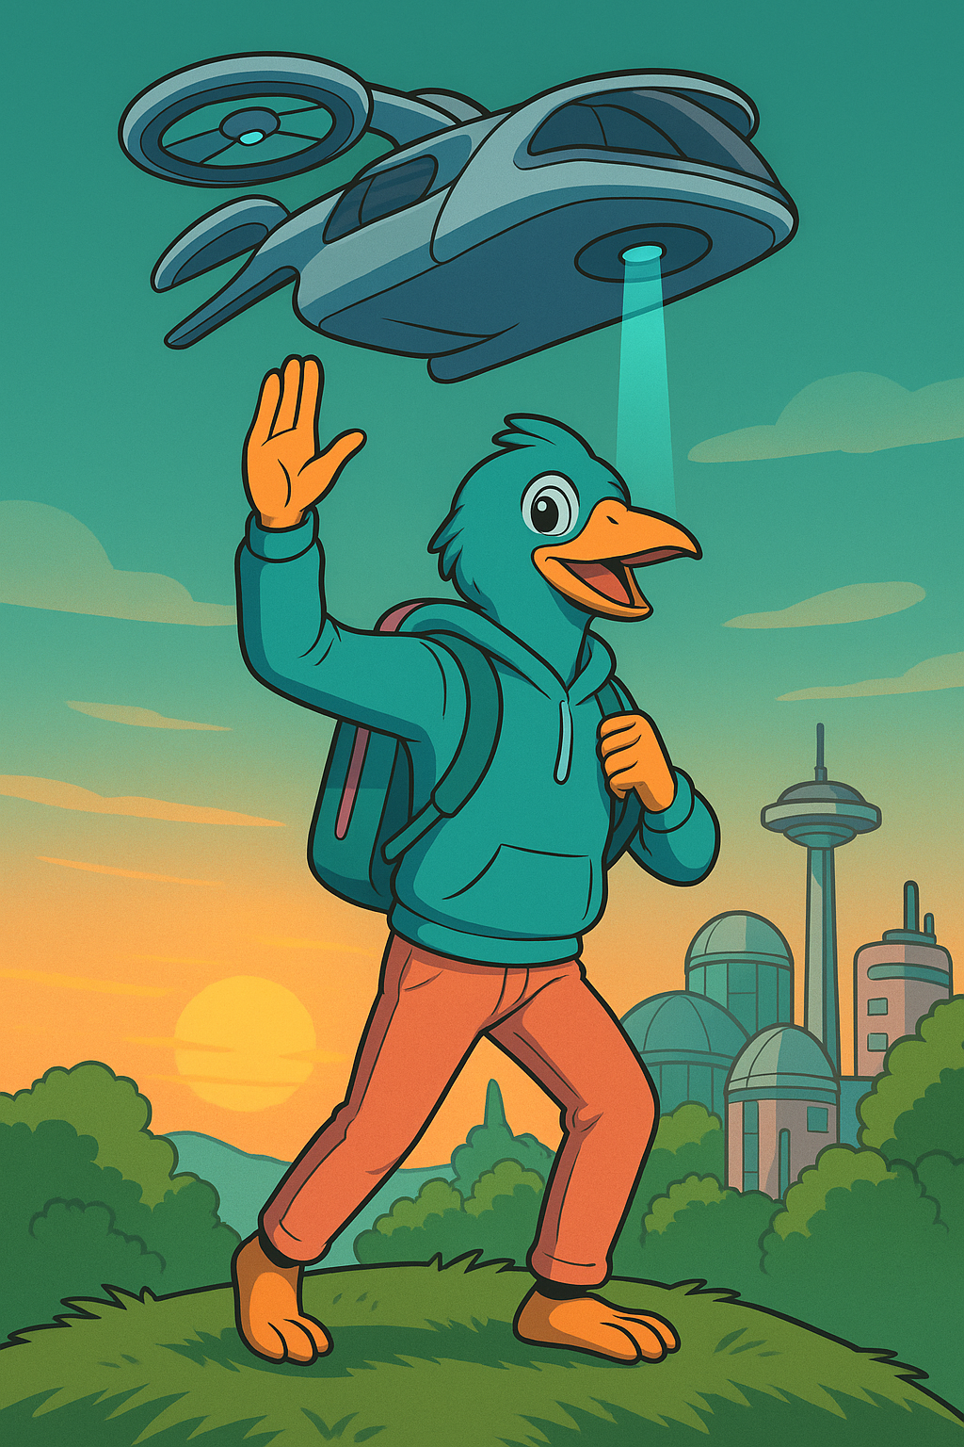
Dawn of Freedom
He felt the world stir inside him, part elation, part ache. To leave the known hill was to leave the self he once was. Yet beyond lay the promise of mornings uncounted, and duty to the undiscovered corners of his own heart.

Slide 2
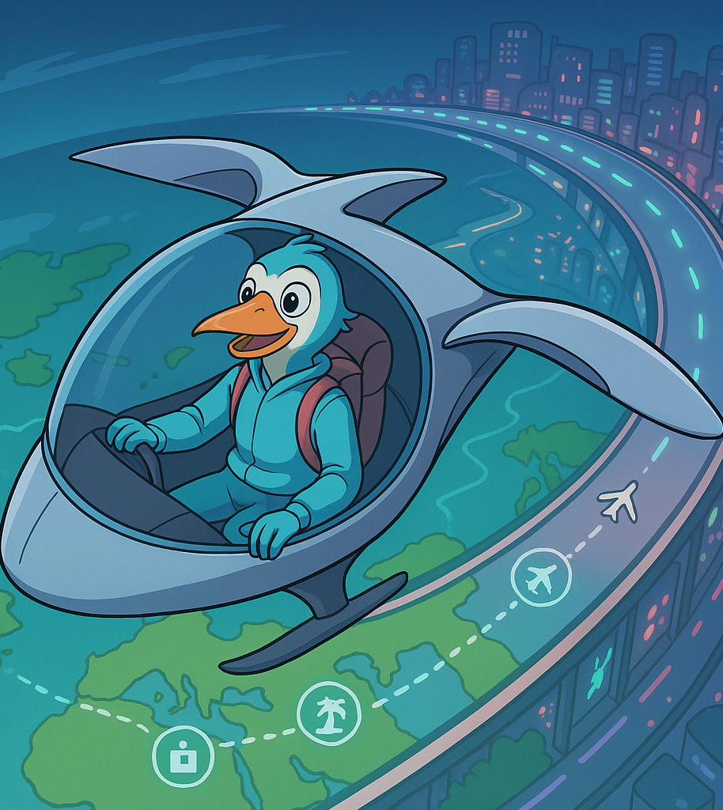
Horizons Unbound
With each latitude he crossed, he sensed lives unfolding beneath: a fisherman singing on the Adriatic, a coder watching night swallow Tokyo. Their joys and fears threaded through his feathers, reminding him that freedom is never solitary; it is shared air.

Slide 3
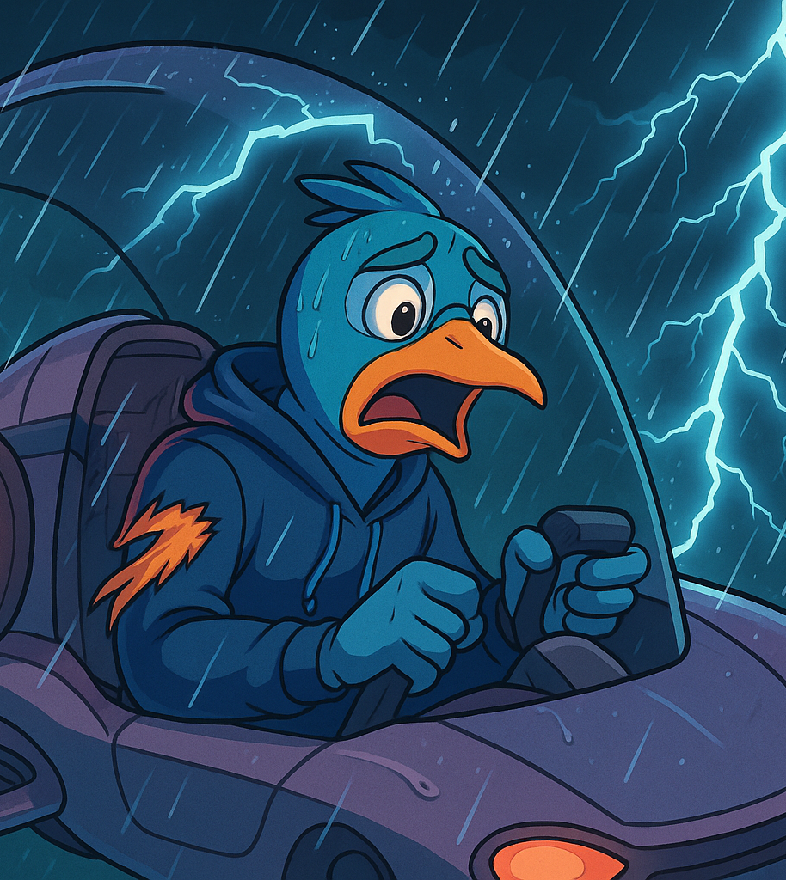
Tempest & Trial
When the storm cleaved the sky, pain lanced his wing. In that instant he confronted the dread Tolstoy once laid bare: that destiny can be cruelly indifferent. Yet he also recalled the author’s countertruth; men and birds alike hold agency in how they bear their wounds.

Slide 4

The Net Revealed
As he plummeted toward the dark, the net appeared; not as a miracle, but as the collective goodwill of countless unseen hands. “One soul’s fall is many souls’ concern,” Tolstoy might have said, and the bird understood: interdependence is the highest form of courage

Slide 5
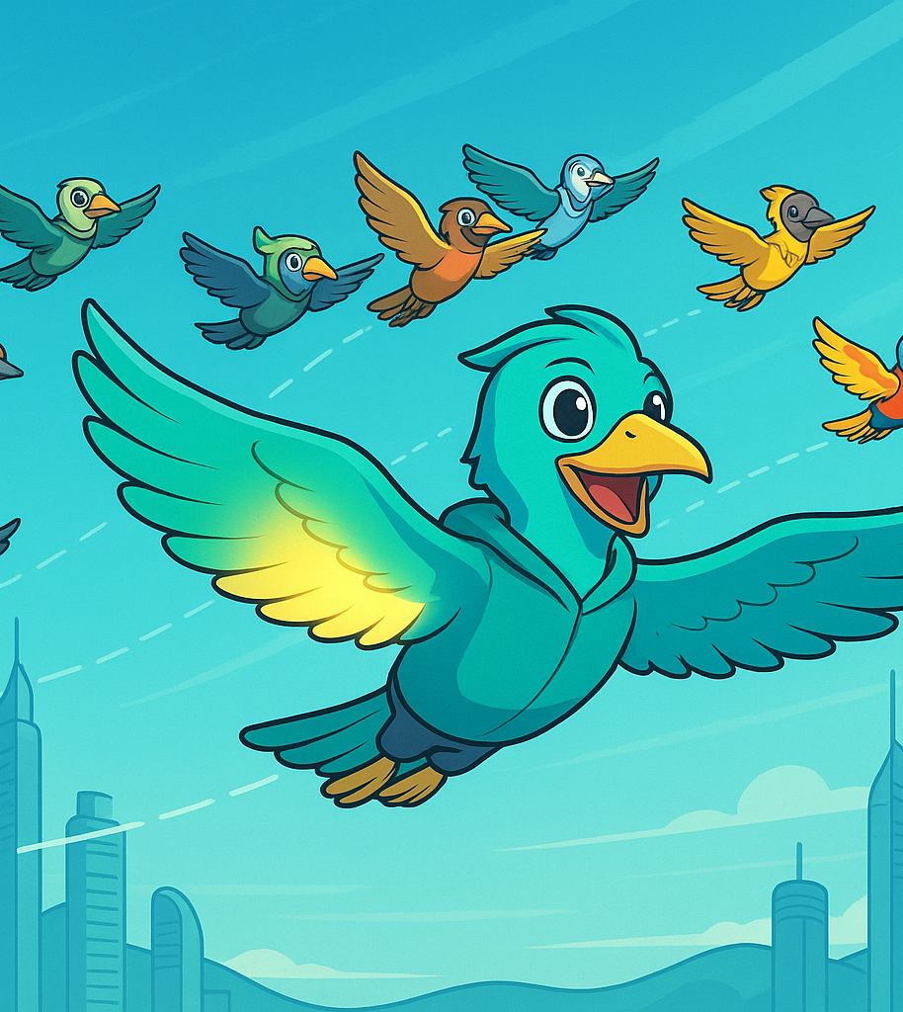
Rebirth of the Flock
He rose again, now marked by a glimmer where the tear had been. Others joined him; some scarred, some untested; all drawn to the quiet conviction in his flight. They discovered a paradox: the more they relied on the net, the bolder their paths became.

Slide 6
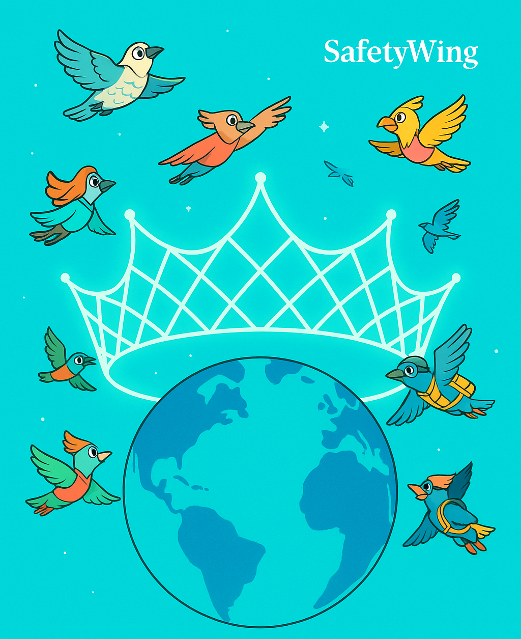
Coronation of a Category King
High above the turning globe, the net shimmered like a coronet. It was no tyrant’s crown but a covenant: to guard every journey without chaining a single wing. Thus SafetyWing ascended; not merely as insurer, but as steward of a borderless society in motion.
“For the sky is wide, but wider still the human heart when it knows it will be caught.”

